Slide 1

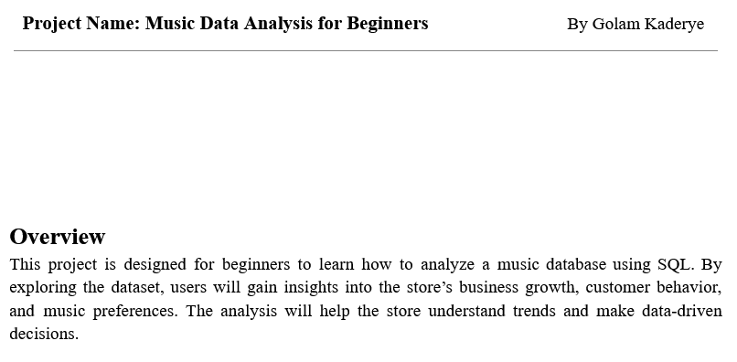
Developed by Golam Kaderye

Slide 2
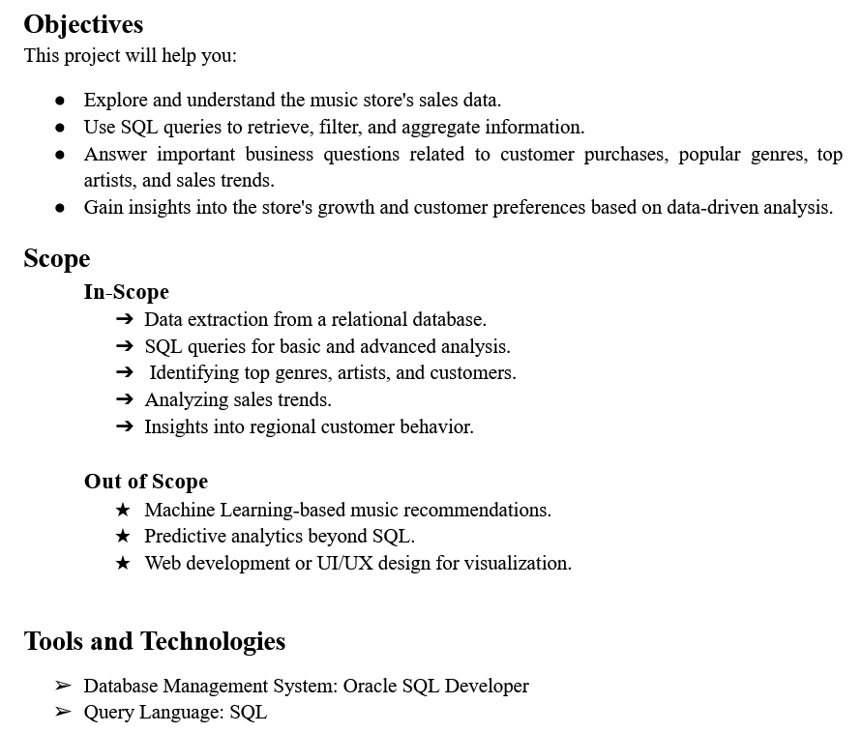

Developed by Golam Kaderye

Slide 3
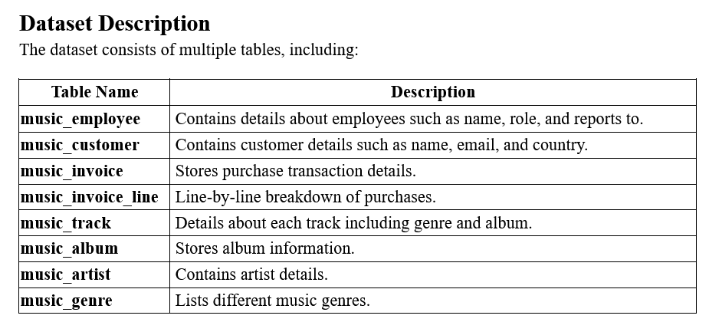

01
Developed by Golam Kaderye

Slide 4

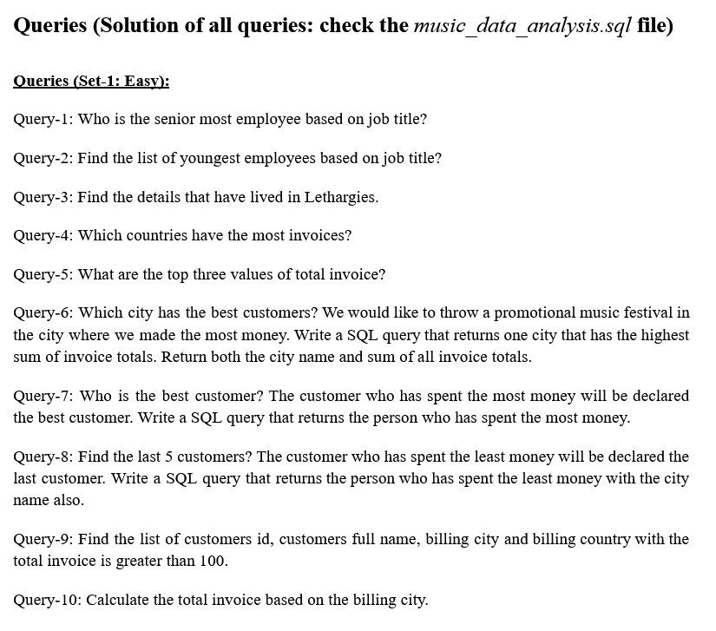


Developed by Golam Kaderye

Slide 5
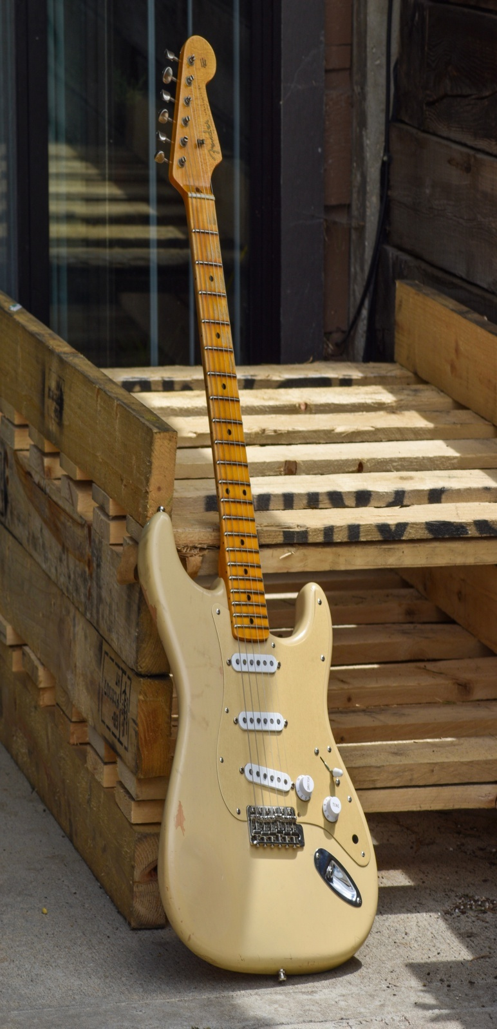

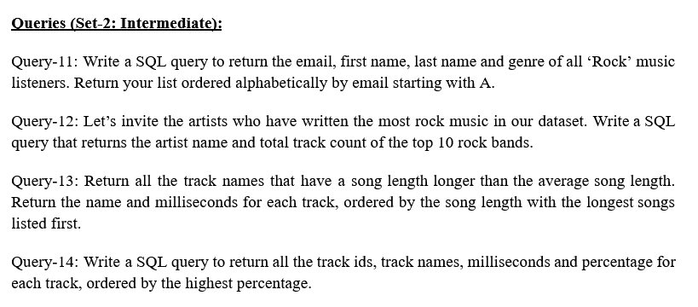

Developed by Golam Kaderye

Slide 6
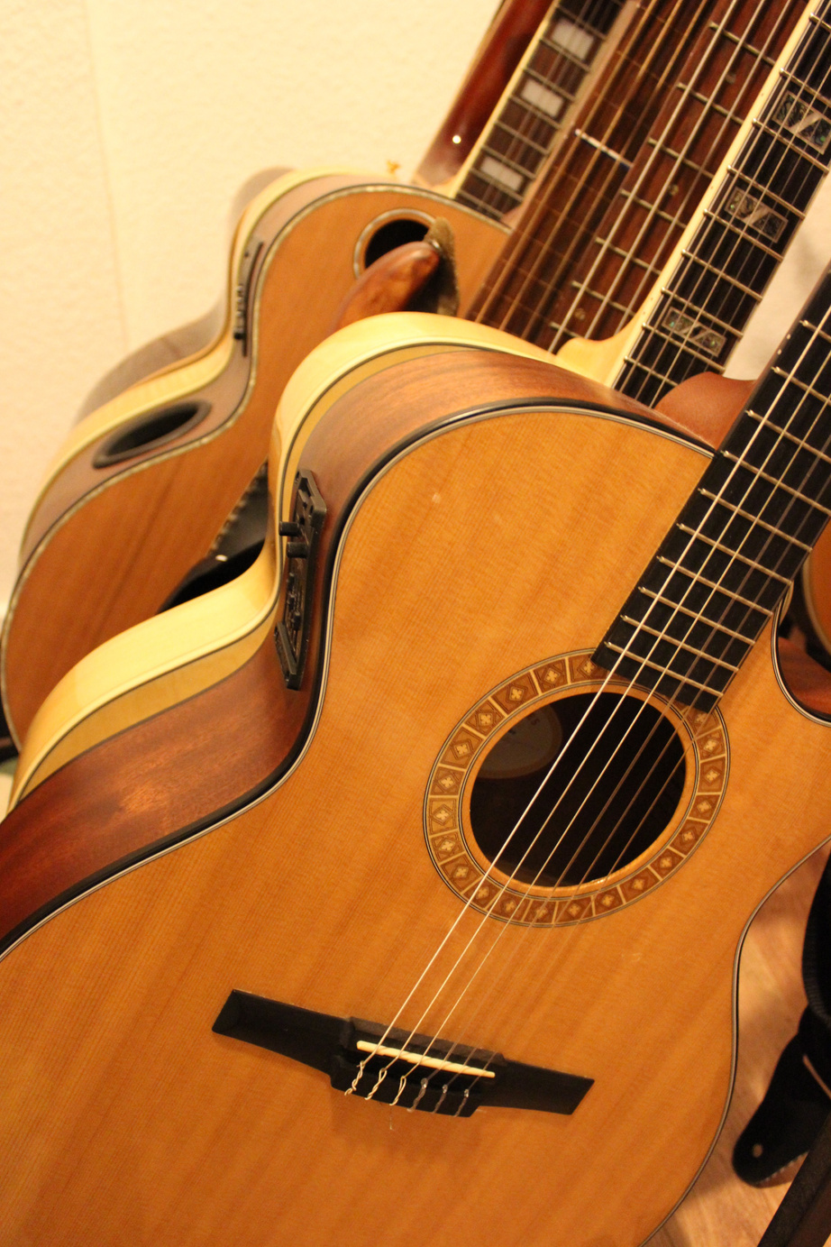
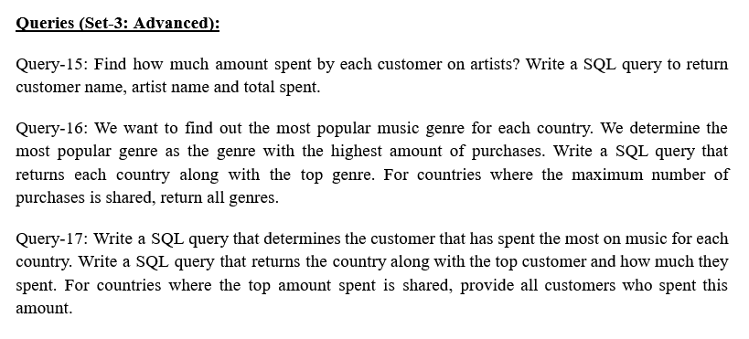
Developed by Golam Kaderye

Slide 7
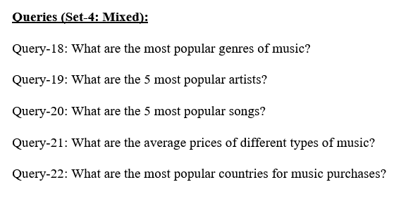


Developed by Golam Kaderye

Slide 8


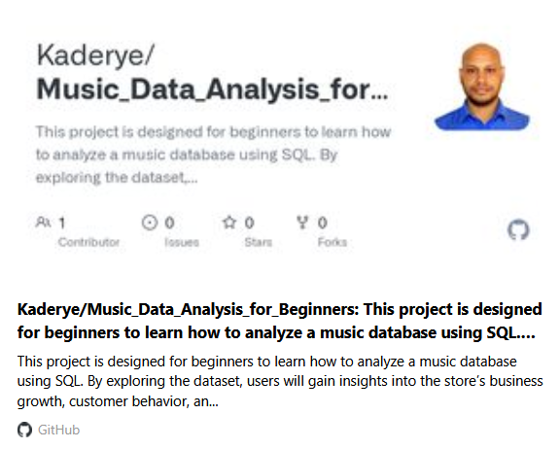
To view the solution of all queries, double-click the image
To view the solution of all queries: https://github.com/Kaderye/Music_Data_Analysis_for_Beginners.git
Developed by Golam Kaderye

Slide 9



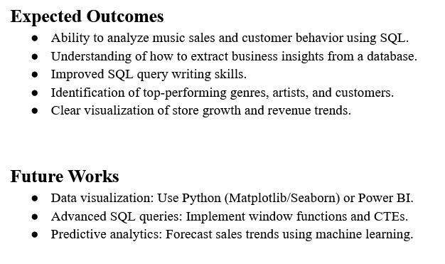
Developed by Golam Kaderye

Slide 10


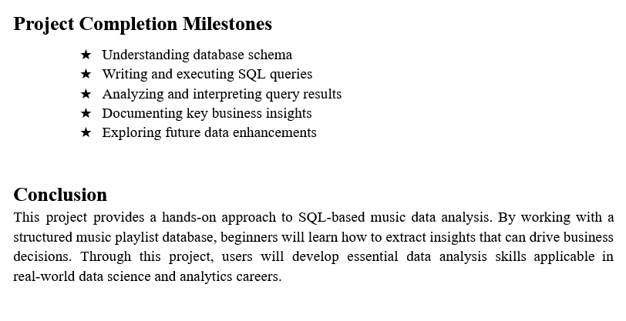
Developed by Golam Kaderye

